Slide 1
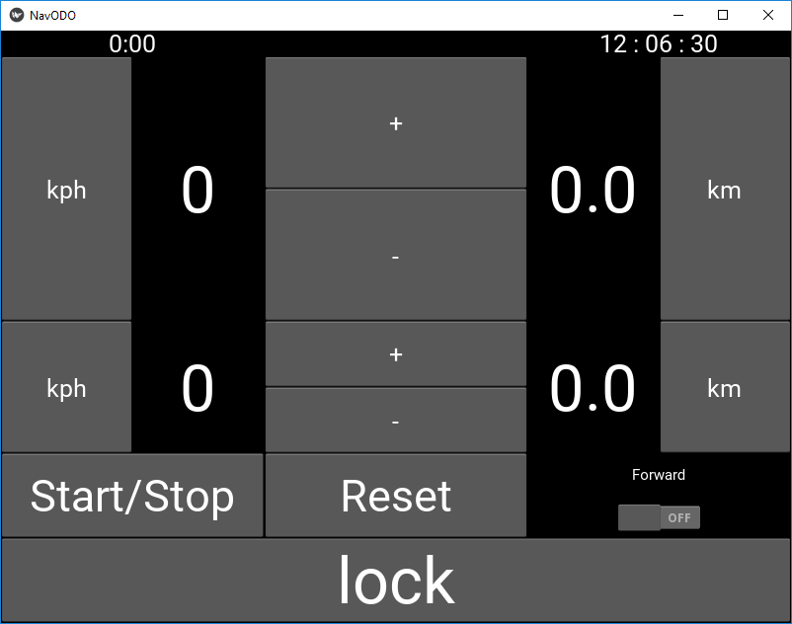
Section ODO temporary add offset
Section ODO temporary subtract offset
Stopwatch Display
Time of day (pulls system time)
CAS display
Reset CAS
Section ODO zero
Current vehicle speed
Section ODO Display
Stage ODO Display
Update speed
Stage ODO zero
Stopwatch Start/Stop
ODO direction (for when the road was back there)
Stopwatch Reset
Anti-bump Lock (not implemented)
Stage ODO temporary subtract offset
Stage ODO temporary add offset

